Slide 1
Committee Meeting June 16, 2014 Karl Jarvis
Committee Members: Paul Beier
Brett Dickson (call)
Jason Wilder
Sam Cushman (absent)

Slide 2
Chapters
Simulations on the effect of road avoidance and roadkill on genetic patterns
Empirical analysis of two desert kangaroo rat populations (and possibly a Merriam’s kangaroo rat population) in areas bisected by roads and pairing with simulations to infer road impacts
Pairing of simulations with data sets on various wildlife species to infer road avoidance and roadkill impacts on genetic patterns

Slide 3
Previous sims
No barrier
Results
IBD: higher diversity in center
Roadkill barrier: higher diversity near road
Avoidance barrier: difference in diversity levels across road
Issues
Computation time
Scaling to many runs/sGD analyses
Edge effect/shape
Solutions
Comp time
Less individuals (1000 -> 500)
Unequal starting allele frequencies
Scaling
Coding to deal with loops, NAs, file management, etc.
Edge effect/shape
Stretched study area
Crop margins
Avoidance Barrier
Mortality Barrier

Slide 4
CDPOP: N generations based on Ho

Slide 5
CDPOP: Informing initial allele frequencies
10x 1000-generation runs

Slide 6
Changes in sims from previous
Results:
Essentially random
Issues:
Changed extent/resolution when I went to different shape

Slide 8
Changes to simulations in progress
Regular grid instead of random
Calibrate movement based on IBD, use to decide on relative value of IBD cells, barrier, and dispersal
Test new Shirk sGD code (now R, was Python)

Slide 9
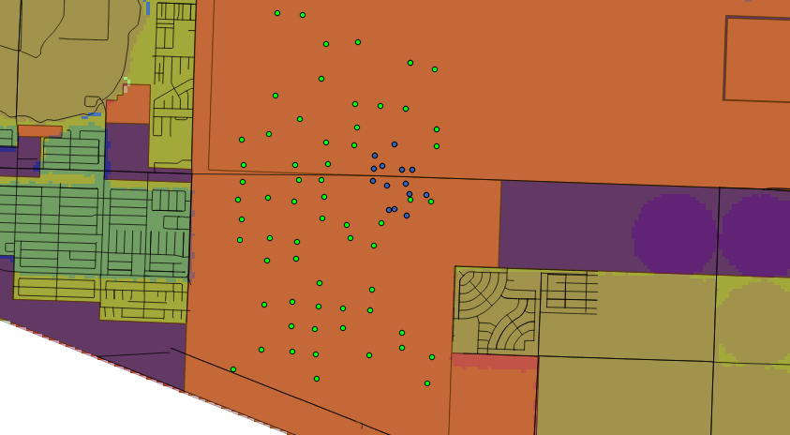
Yuma Desert Kangaroo Rats green=this year, purple=last year

Slide 10
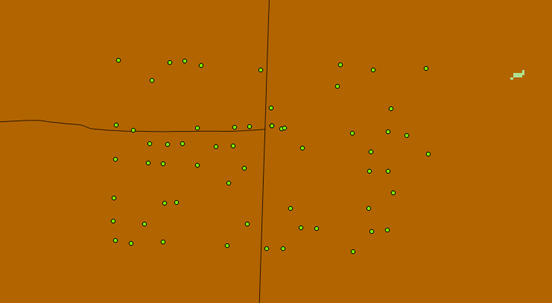
Quarzsite AZ-95 Desert K-Rats

Slide 11
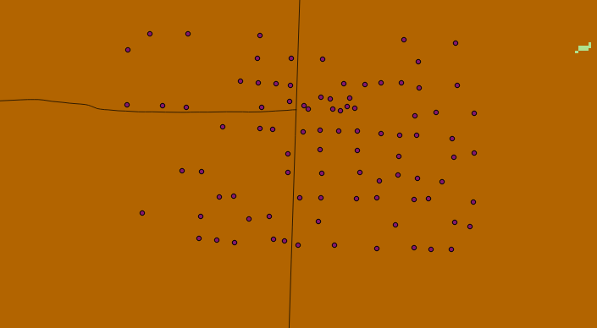
Same study site: Merriam’s K-Rats

Slide 12
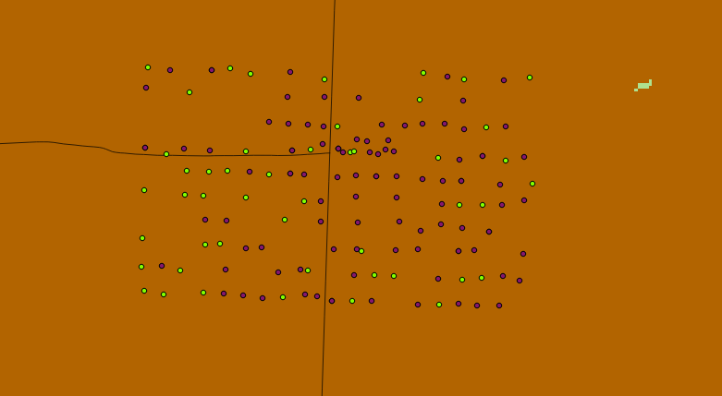
Quatzsite Desert & Merriam’s Kangaroo Rat Samples (some points with multiple individuals)

